Slide 1

Работу выполнили студенты группы ПИ19-1: Содиков Фарход Касьянов Максим

Slide 2
Plan
1. Plan
2. What is ICT?
3. ICT situation in the sphere of Russian schools from the regions
4. Suggestions for improvement
5. Benefits from new implementations
6. Drawbacks
7. The Final
8. Thank you for your attention

Slide 3

What is ICT?

Slide 4
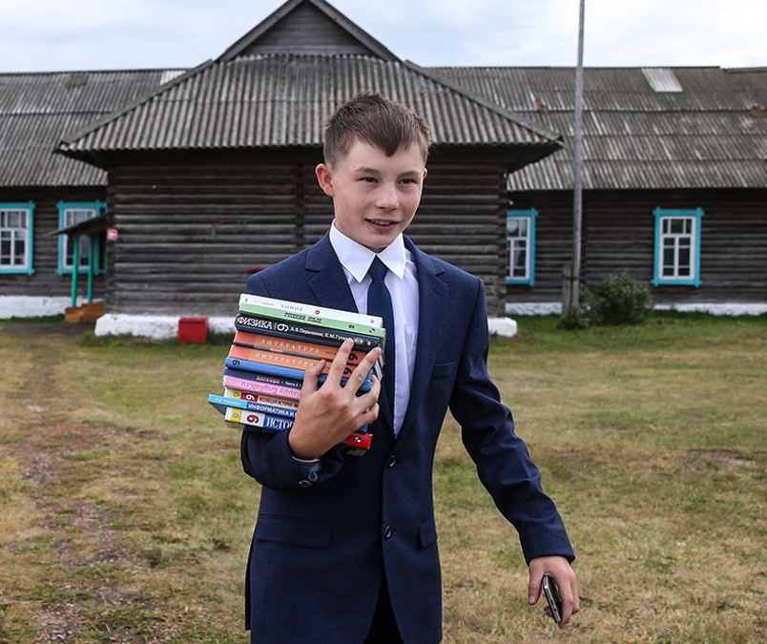
ICT situation in the sphere of Russian schools from the regions
No Wi-Fi
No e-books
No e-diary
No PCs
No electronic devises

Slide 5

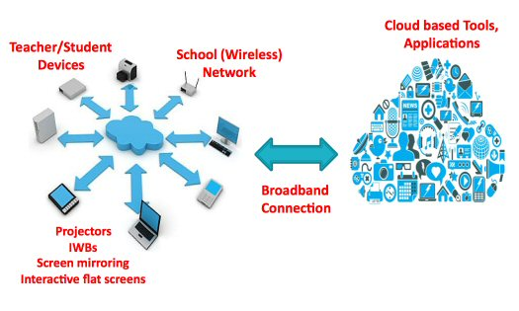
Suggestions for improvement
Internet access
E-books
Electronic boards
Electronic diary system
Laptops or PCs

Slide 6

Benefits from new implementations
Convenience
Quick access to information
Easy accounting of school grades and school costs
…

Slide 7


Drawbacks
1. Costs
2. Service and specialists

Slide 8
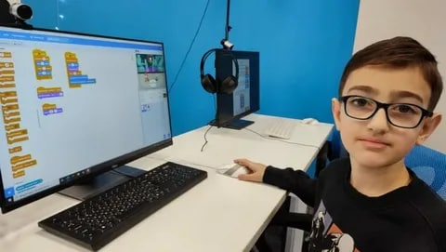
The Final

Slide 9

Thank you for your attention

